Slide 1
Marketing on the Web
SE-413, Week 3
© Cengage Learning 2015

Slide 2
Learning Objectives
In this chapter, you will learn:
How firms use product-based and customer-based marketing strategies
About communicating with different market segments
To identify customer’s characteristics as they move through the customer relationship life cycle
How companies advertise on the Web
© Cengage Learning 2015

Slide 3
Learning Objectives (cont’d.)
About e-mail marketing strategies
About technology-enabled customer relationship management
How to create and maintain brands on the Web
How businesses use social media in viral marketing campaigns
About search engine positioning tactics and domain name selection strategies
© Cengage Learning 2015

Slide 4
Introduction
Case study: The Moths
  The Moths began as a storytelling group: the Moth Radio hour on National Public Radio
  The Moths started giving corporate training
    Businesses and organizations are interested in telling their story to customers
    It is a tool for creating emotions in your target groups, which gives your customers a sense of engagement and a better understanding of your values.
    Stories can be told in various channels
© Cengage Learning 2015

Slide 5
Web Marketing Strategies
Marketing mix
  Element combination to achieve goals
    Selling and promoting products and services
Marketing strategy
  Marketing mix with elements defined
© Cengage Learning 2015

Slide 6
The Four Ps of Marketing
Product
  Physical item or service sold
  Brand: customers’ product perception
Price
  Amount customer pays for product
  Customer value: customer benefits minus total cost
Promotion
  Any means to spread word about product
© Cengage Learning 2015

Slide 7
The Four Ps of Marketing (cont’d.)
Place (distribution)
  Need to have products or services available in many different locations
  Getting right products to the right places at the best time to sell them
© Cengage Learning 2015

Slide 8
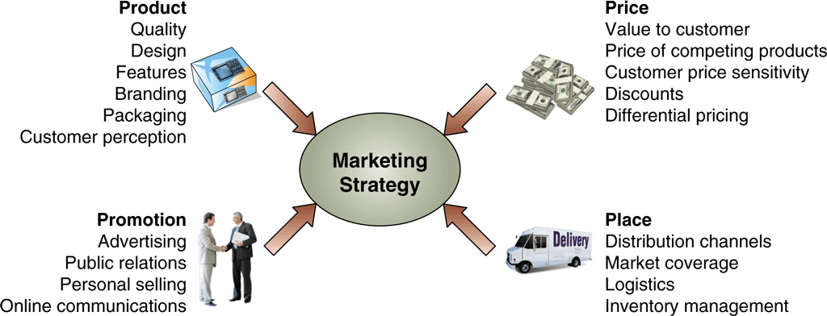
FIGURE 4-1 The four Ps of marketing contribute to marketing strategy
© Cengage Learning 2015
© Cengage Learning 2015

Slide 9
Product-Based Marketing Strategies
Managers often think in terms of products and services sold
  This is a useful Web site design when customers use product categories
    Web site examples: Home Depot and Staples
  This is not a useful Web site design when customers look to fulfill a specific need
Design Web site to meet individual customer needs
  Offer alternative shopping paths
© Cengage Learning 2015

Slide 10
Customer-Based Marketing Strategies
Web sites to meet various types of customers’ specific needs
  Initial step: identify customer groups sharing common characteristics
  Make site more accessible and useful for each group
Companies need to take view beyond internal perspective
  Example: university Web sites today focus design on needs of stakeholders (current students, prospective students, parents of students, potential donors, faculty)
© Cengage Learning 2015

Slide 11
Communicating with
Different Market Segments
Communications media selection to carry message
  Online firm
    Communications media selection: critical
    No physical presence
    Customer contact made through image projected through media and Web site
  Online firm challenge
    Obtain customer trust with no physical presence
© Cengage Learning 2015

Slide 12
Trust, Complexity, and Media Choice
The Web
  Intermediate step between mass media and personal contact
Web communication offers:
  Advantages of personal contact selling
  Cost savings of mass media
Mass media advertising offers lowest trust level
  Still used successfully because costs spread over many people
© Cengage Learning 2015

Slide 13
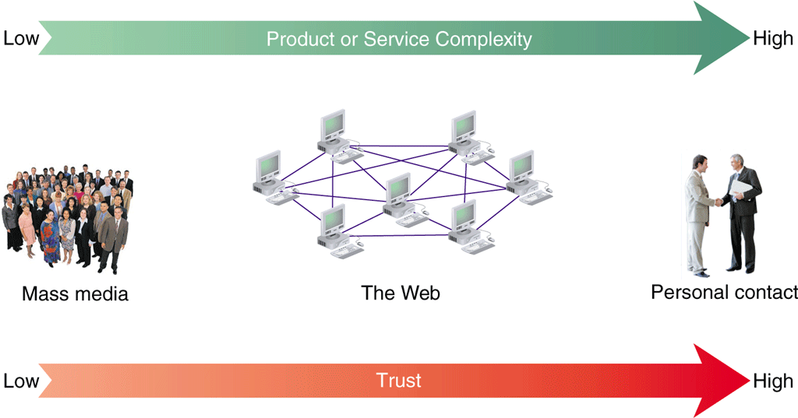
FIGURE 4-2 Trust in three communication modes
© Cengage Learning 2015
© Cengage Learning 2015

Slide 14
Trust, Complexity, and Media Choice (cont’d.)
Complexity level inherent in product and service
  Important factor in media choice
Mass media
  Lowest level of trust
  Low cost per viewer
  Success depends on passive nature of media consumption
Personal contact
  Highly complex products and services
  Customers may ask questions
© Cengage Learning 2015

Slide 15
Trust, Complexity, and Media Choice (cont’d.)
Web occupies a wide middle ground
  Short, focused messages
  Long, complex messages
  Back and forth dialog with customers
Web log (blog)
  Website that allows people to post thoughts and inviting others to add commentary
  Used by many companies as a communication device
© Cengage Learning 2015

Slide 16
Trust, Complexity, and Media Choice (cont’d.)
Social media
  Examples: Facebook, Google+, Twitter
  Can help companies create consistently-themed discussions
© Cengage Learning 2015

Slide 17
Offering Customers a
Choice on the Web
One-to-one marketing
  Offering products and services matched to needs of a particular customer
Example: Dell
  Offers several different ways to do business
  Home page links for each major customer group
    Specific products, product categories links available
  Dell Premier accounts
    High level of customer-based market segmentation
© Cengage Learning 2015

Slide 18
Beyond Market Segmentation: Customer Behavior and Relationship Intensity
Recap
  Companies target similar customer groups as market segments
  One-to-one marketing
    Chance to create individually unique Web experiences
Next step
  Use the Web to target specific customers in different ways at different times
© Cengage Learning 2015

Slide 19
Segmentation Using
Customer Behavior
Same person
  Needs different combinations of products and services
    Depending on the occasion
Behavioral segmentation
  Creation of separate customer experiences based on behavior
Occasion segmentation
  Behavioral segmentation based on things happening at a specific time or occasion
© Cengage Learning 2015

Slide 20
Segmentation Using
Customer Behavior (cont’d.)
Online world single Web site design
  Easier to meet needs of different behavioral modes
  Can include elements appealing to different behavioral segments
Usage-based market segmentation
  Customizing visitor experiences to match the site usage behavior patterns of each visitor or type of visitor
Categories of online behavior patterns
  Browsers, buyers, and shoppers
© Cengage Learning 2015

Slide 21
Browsers
Visitors usually surf or browse sites
A Web site must offer something to pique visitors’ interest
Trigger words
  Prompt visitor to stay and investigate products or services
Have links to site explanations, instructions
Include extra content related to product, service
  Leads to favorable impression (bookmark)
© Cengage Learning 2015

Slide 22
Buyers
Ready to make a purchase right away
Offer direct route into purchase transaction
Shopping cart
  Part of the Web site
  Keeps track of selected items for purchase
  Automates purchasing process
  Page offers link back into shopping area
Primary goal: get buyer to shopping cart as quickly as possible
© Cengage Learning 2015

Slide 23
Shoppers
Motivated to buy
Looking for more information before purchase
Offer comparison tools, product reviews, and features lists
People do not retain behavioral categories from one visit to the next
  Even for the same Web site
© Cengage Learning 2015

Slide 24
Customer Relationship Intensity and Life-Cycle Segmentation
One-to-one marketing and usage-based segmentation value
  Strengthen companies’ relationships with customers
Good customer experiences
  Create intense loyalty feeling
Typical five-stage model of customer loyalty
  First four stages show increase in relationship intensity
  Fifth stage (separation)
    Decline occurs, relationship terminates
© Cengage Learning 2015

Slide 25
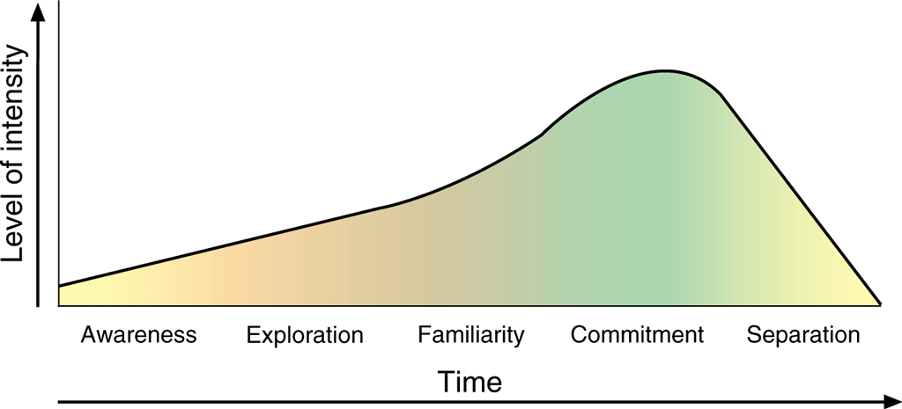
FIGURE 4-5 Five stages of customer loyalty
© Cengage Learning 2015
© Cengage Learning 2015

Slide 26
Customer Acquisition:
The Funnel Model
Conceptual tool
  Provides understanding of overall nature of marketing strategy
  Clear structure for evaluating specific strategy elements
Similar to customer life-cycle model
  Less abstract
  Better at showing effectiveness of two or more specific strategies
© Cengage Learning 2015

Slide 27
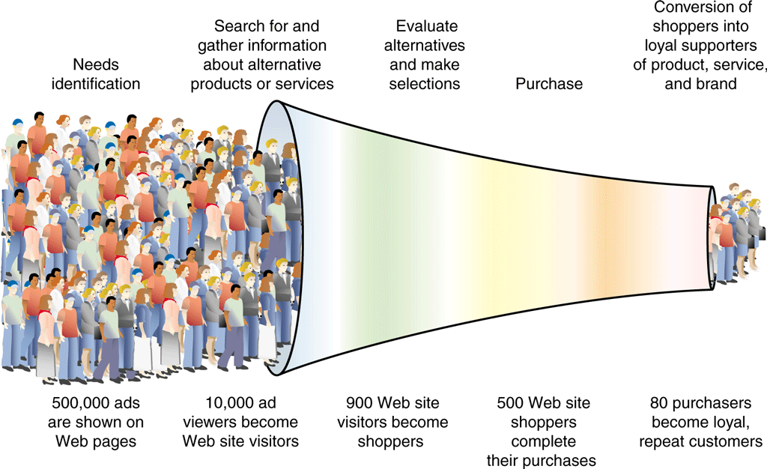
FIGURE 4-6 Funnel model of customer acquisition
© Cengage Learning 2015
© Cengage Learning 2015

Slide 28
Costs of Customer Acquisition, Conversion, and Retention
Acquisition cost
  Amount of money spent to bring one customer to the site
Conversion
  Converting a visitor into a customer
Conversion cost
  May be greater than profit realized on first sale
Retained customers return to site again
  Retention cost
© Cengage Learning 2015

Slide 29
Advertising on the Web
Five-stage customer loyalty model helpful in creating advertising messages
  Awareness stage: message should inform
  Exploration stage: message should explain how product, service works
    Encourage switching brands
  Familiarity stage: message should persuade
  Commitment stage: customer sent reminder messages
  Separation stage customers not targeted
© Cengage Learning 2015

Slide 30
Advertising on the Web (cont’d.)
Online advertising
  Must coordinate with existing advertising efforts
© Cengage Learning 2015

Slide 31
Banner Ads
Small rectangular object with stationary or moving graphic
Includes hyperlink to advertiser’s Web site
  Versatile: informative and persuasive functions
Leaderboard ad
  Designed to span Web page top or bottom
Skyscraper ad
  Designed to be placed on Web page side
© Cengage Learning 2015

Slide 32
Banner Ad Placement
Use a banner exchange network
  Coordinates ad sharing
  HitExchange, Voltrank
Find Web sites appealing to company’s market segments
  Pay sites to carry ad
Use a banner advertising network
  Acts as broker between advertisers and Web sites that carry ads
  DoubleClick (Google), ValueClick
© Cengage Learning 2015

Slide 33
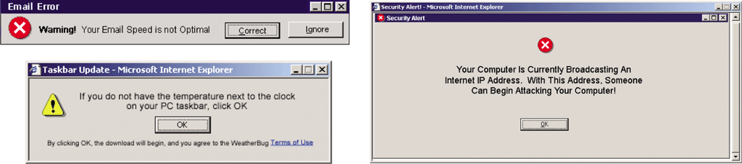
FIGURE 4-7 Disguised banner ads
© Cengage Learning 2015
© Cengage Learning 2015

Slide 34
Text Ads
Short promotional message
  No graphic elements
  Usually placed along Web page top or right side
Deceptively simple but very effective
Example: Google
  Initially criticized for including unobtrusive ads on its pages
  Now clearly labels ads to prevent confusion
Inline text ad
  Text in stories displayed as hyperlinks
© Cengage Learning 2015

Slide 35
Other Web Ad Formats
Pop-up ad
  Appears in its own window when user opens/closes Web page
  Considered an annoyance
  Must click close button (small) in window of ad
Pop-behind ad
  Pop-up ad followed by a quick command
  Returns focus to original browser window
  Appears when browser is closed
Ad-blocking software
  Prevents banner ads and pop-up ads from loading
© Cengage Learning 2015

Slide 36
Other Web Ad Formats (cont’d.)
Rich media ads (active ads)
  Generate graphical activity that “floats” over the Web page itself
  Example: 30 second ad before television show
© Cengage Learning 2015

Slide 37
Mobile Device Advertising
Tremendous usage growth for mobile devices connected to Internet
Some mobile software applications (mobile apps) include advertising element
  Messages displayed from advertisers
  Part of the app screen or in a separate screen
  Mobile apps’ advertising space marketed in same way as Web sites’ banner advertising
© Cengage Learning 2015

Slide 38
Site Sponsorships
Web sites offer advertisers opportunity to sponsor all (or parts) of their sites
  More subtle
Goals similar to sporting event sponsors, television program sponsors
  Tie company (product) name to an event (set of information)
Ethical concerns raised
  If sponsor is allowed to create content or weave advertising message into site’s content
© Cengage Learning 2015

Slide 39
Online Advertising Cost and Effectiveness
Companies want Web sites to make favorable impression on potential customers
Raises issue of measuring Web site effectiveness
Cost per thousand (CPM) for mass media advertising
  “M” from Roman numeral for “thousand”
  Dollar amount paid for every thousand people in the estimated audience
Cost per click (CPC)
© Cengage Learning 2015

Slide 40
Online Advertising Cost and Effectiveness (cont’d.)
Page view
  Each page loaded by a visitor
Ad view
  Occurs if page contains an ad
Impression
  Each time banner ad loads
Click (click-through)
  Action whereby a visitor clicks banner ad to open advertiser’s page
© Cengage Learning 2015

Slide 41
Effectiveness of Online Advertising
Effectiveness remains difficult to measure
Major problem
  Lack of single industry standard measuring service
Solution (2004)
  Set of media measurement guidelines
    Used by all online advertisers
    Produce comparable ad view numbers
Difficulties remain
  Site visitors change Web surfing behaviors, habits
© Cengage Learning 2015

Slide 42
Effectiveness of
Online Advertising (cont’d.)
Online advertising as one element in marketing strategy
  Use variety of media to reach potential customers
Online advertising developments
  AdAge.com, eMarketer, Online Publishers Association
Online advertising much more effective using market segmentation
© Cengage Learning 2015

Slide 43
E-Mail Marketing
Can be a powerful element of advertising strategy
  Used to announce new products or features
  Used to announce sales on existing products
Unsolicited Commercial E-mail (UCE, Spam, bulk mail)
  Electronic junk mail
  Wastes time, disk space, and consumes large amounts of Internet capacity
Key element to avoid engaging in spam
  Obtain customer approval prior to sending
© Cengage Learning 2015

Slide 44
Permission Marketing
Conversion rate
  Percentage of recipients responding to an ad or promotion
  Ranges from 10 percent to more than 30 percent on requested e-mail messages
Opt-in e-mail
  Practice of sending e-mail messages to people who request information
  Part of marketing strategy: permission marketing
  Example companies: ConstantContact, Yesmail, Return Path
© Cengage Learning 2015

Slide 45
Combining Content and Advertising
Using articles, news stories of interest to specific market segments
  Increases acceptance of e-mail
Advertisers send content by using hyperlinks inserted into e-mail messages
  Takes customers to advertiser’s Web site content
  Easier to induce customer to stay on the site and consider making purchases
Coordination across media outlets
  Important element in any marketing strategy
© Cengage Learning 2015

Slide 46
Outsourcing E-Mail Processing
Number of customers opting in to information-laden e-mails
  Can outgrow capacity of an information technology staff
Solution
  Use e-mail processing service provider
  Manage e-mail campaign at cost of 1-5 cents per address
© Cengage Learning 2015

Slide 47
Technology-Enabled Customer Relationship Management
Clickstream: the information gathered about visitors
Technology-enabled relationship management
  Firm obtains information on customer behavior to:
    Set prices, negotiate terms, tailor promotions, add product features, customize customer relationship
  Also known as:
    Customer relationship management (CRM)
    Technology-enabled customer relationship management
    Electronic customer relationship management (eCRM)
© Cengage Learning 2015

Slide 48
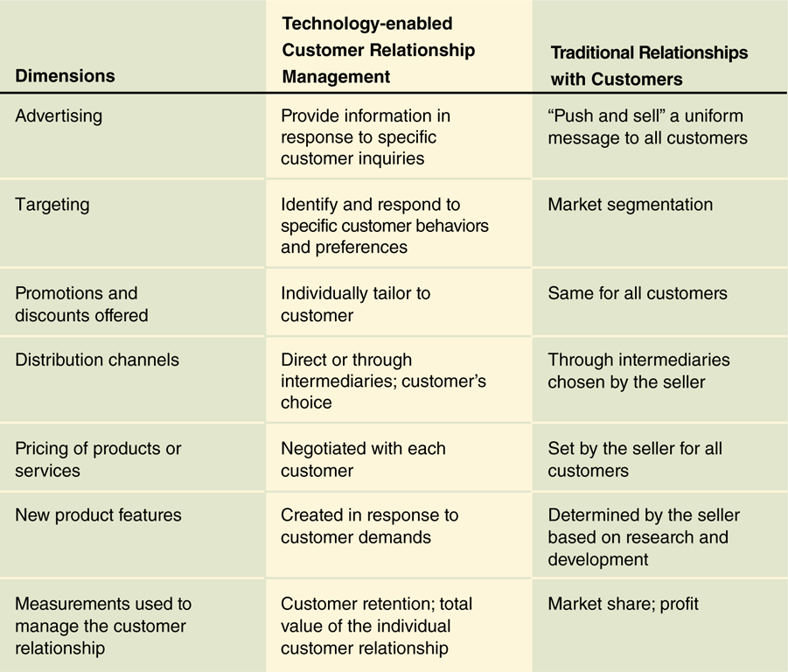
FIGURE 4-9 Technology-enabled relationship management
and traditional customer relationships
© Cengage Learning 2015
© Cengage Learning 2015

Slide 49
CRM as a Source of Value
Marketspace
  Commerce in the information world
Value creation requires different processes
Information itself a source of value
Track and examine Web site visitor behavior
  Use information to provide customized, value-added digital products and services
Early CRM efforts failed
  Overly complex
© Cengage Learning 2015

Slide 50
CRM as a Source of Value (cont’d.)
Today’s CRM efforts more successful
  Limit data collection to key facts
  Automating data collection
Customer touchpoint
  Any occurrence of contact between customer and any company point
Data warehouse (large database)
  Contains multiple sources of information about customers, their preferences, their behavior
© Cengage Learning 2015

Slide 51
CRM as a Source of Value (cont’d.)
Data mining (analytical processing)
  Technique that examines stored information
  Looks for unknown, unsuspected patterns in the data
Statistical modeling
  Technique that tests CRM analysts’ theories about relationships among customer and sales data elements
© Cengage Learning 2015

Slide 52
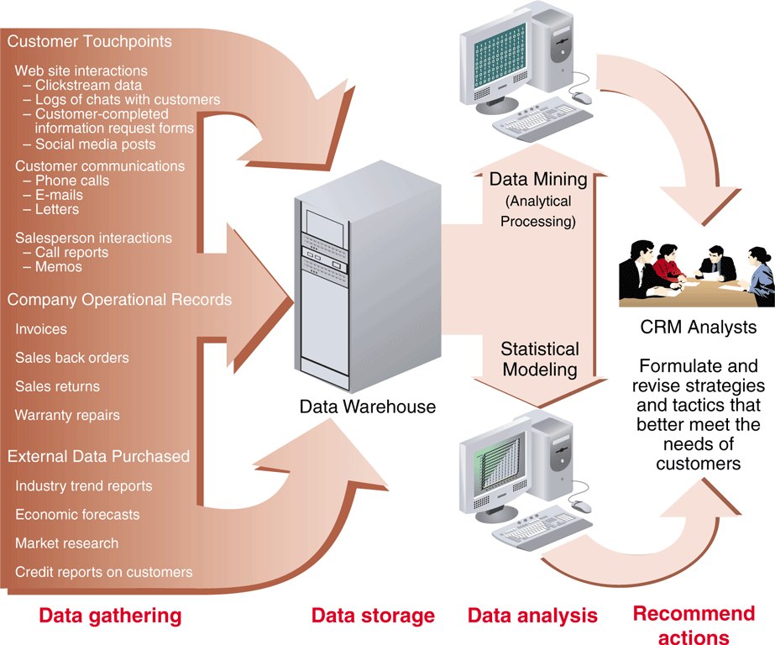
FIGURE 4-10 Elements of a typical CRM system
© Cengage Learning 2015
© Cengage Learning 2015

Slide 53
Creating and Maintaining Brands on the Web
Branded products
  Easier to advertise and promote
  Each product carries reputation of the brand name
Value of trusted major brands
  Far exceeds cost of creating them
© Cengage Learning 2015

Slide 54
Elements of Branding
Three key brand elements
  Differentiation
    Clearly distinguishes product from all others
  Relevance
    Degree to which product offers utility to customer
  Perceived value (key element)
    Customer perceives a value in buying product
Brands can lose their value
  Due to environmental changes
© Cengage Learning 2015

Slide 55
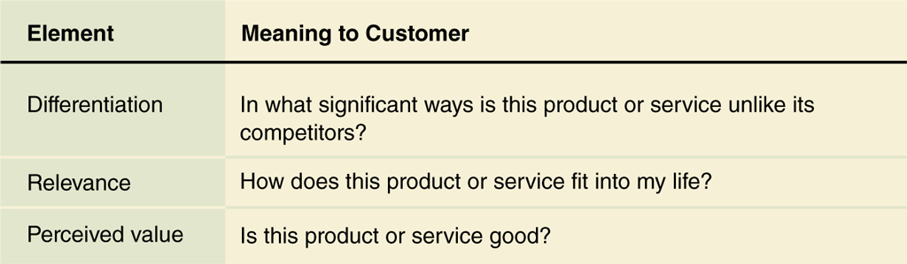
FIGURE 4-11 Elements of a brand
© Cengage Learning 2015
© Cengage Learning 2015

Slide 56
Emotional Branding vs.
Rational Branding
Emotional appeals
  Work well if ad targets in passive mode of information acceptance
    Television, radio, billboards, print media
  Difficult to convey on Web
    Active medium controlled by customer
Rational branding
  Offer to help Web users in some way
    In exchange for viewing an ad
  Relies on cognitive appeal of specific help offered
© Cengage Learning 2015

Slide 57
Affiliate Marketing Strategies
One firm’s Web site (affiliate site)
  Includes descriptions, reviews, ratings, other information about a product linked to another firm’s site (offers item for sale)
Affiliate saves expenses
  Handling inventory, advertising and promoting product, transaction processing
Affiliate commissions
  Pay per click, pay per conversion
© Cengage Learning 2015

Slide 58
Affiliate Marketing Strategies (cont’d.)
Affiliate program broker
  Rakuten LinkShare, Commission Junction
Cause marketing
  Affiliate marketing program that benefits charitable organization
  Visitor clicks on link (on affiliate’s Web page)
    Donation made by a sponsoring company
  Page loads after visitor clicks donation link
    Carries advertising for sponsoring companies
  Higher click-through rates than typical banner ad
© Cengage Learning 2015

Slide 59
Viral Marketing Strategies and Social Media
Viral marketing
  Relies on existing customers
    Tell other people (prospective customers) about products or service
  Example: BlueMountain Arts
    Electronic greeting cards
    Greeting card includes link to greeting card site
Social media
  Goal: get community to discuss product or service in a positive way
  Build “fan base” of associated individuals
© Cengage Learning 2015

Slide 60
Search Engine Positioning and
Domain Names
Ways that potential customers find Web sites
  Referral by a friend
  A link on a referring Web site
  Referral by an affiliate marketing partner
  Site’s URL in print advertisement, television
  Unintentional visit after mistyping similar URL
  Use of a search engine or directory Web site
© Cengage Learning 2015

Slide 61
Search Engines and Web Directories
Search engine
  Web site that helps people find things on the Web
Search engine major parts
  Spider (crawler, robot, bot)
    Program that automatically searches Web to find potentially interesting Web pages for people
  Index (database)
    Storage element of search engine
  Search utility
    Takes terms; finds matching Web page entries in index
© Cengage Learning 2015

Slide 62
Search Engines and Web Directories (cont’d.)
Web directories
  Provide classified hierarchical lists of categories
Search engine ranking
  Weighting of factors
    Search engines use factors to decide which URLs appear first on searches for a particular search term
Search engine positioning (search engine optimization, search engine placement)
  Combined art and science of having a particular URL listed near the top of search engine
© Cengage Learning 2015

Slide 63
Paid Search Engine Inclusion and Placement
Paid placement (sponsorship, search term sponsorship)
  Offer good ad placement on search results page for a price
Buy banner ad space at the top of search results pages that include certain terms
Search engine positioning: complex subject
Spending on online advertising
  Grew rapidly in the early Web days
    Virtually zero in 1995 to about $8 billion in 2000 (U.S.)
© Cengage Learning 2015

Slide 64
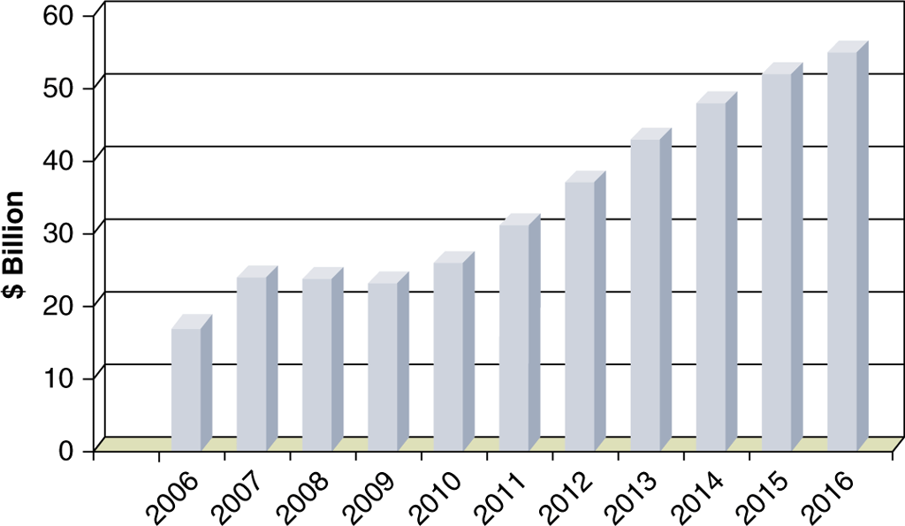
FIGURE 4-12 U.S. online advertising expenditures, actual and projected
Source: Adapted from reports by ClickZ, eMarketer, Forrester Research,
Nielsen, and Internet Retailer
© Cengage Learning 2015

Slide 65
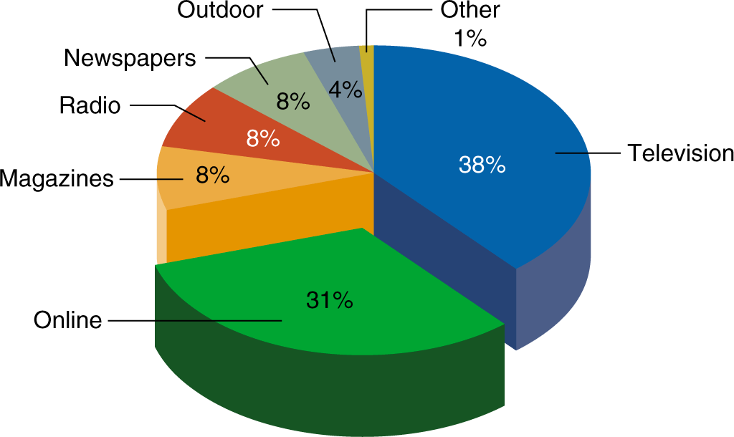
FIGURE 4-13 U.S. advertising expenditures by medium, 2015 estimates
Source: Adapted from reports by eMarketer, MagnaGlobal, and Nielsen
© Cengage Learning 2015

Slide 66
Paid Search Engine Inclusion and Placement (cont’d.)
Search engine placement brokers
  Aggregate inclusion and placement rights on multiple search engines
  Sell combination packages to advertisers
Google does not use placement broker
  Sells services directly (Google AdWords program)
Contextual advertising (potential flaw)
  Ads placed in proximity to related content
Localized advertising
  Ads related to location on search results
© Cengage Learning 2015

Slide 67
Web Site Naming Issues
URLs should reflect company name or reputation
Troublesome domain names
  Purchase more suitable domain names
  Examples:
    www.iflyswa.com changed to www.southwest.com
    www.delta-air.com changed to www.delta.com
Companies often buy more than one domain name
  In case user misspells URL
    Redirected to intended site
  Have different names or forms of names
© Cengage Learning 2015

